Slide 1


IMDb MOVIE ANALYSIS
FINAL PROJECT-1
~ ARYAN AUDITTO

Slide 2

HYPERLINK FOR THE WORKING EXCEL FILE :-
IMDb MOVIE ANALYSIS WORKING FILE
NOTE: All the tasks are shown in this working file and each task is separated into different sheets

Slide 3
PROJECT DESCRIPTION :-
The project aims to perform a detailed analysis of a dataset containing information about movies. The dataset needs to be cleaned first, which involves tasks like dropping columns and removing null values. After cleaning the data, several analyses are performed, including finding movies with the highest profit, identifying the top 250 movies based on IMDb rating and number of voted users, determining the best directors based on average IMDb score, identifying popular genres, and analyzing the performance of specific actors. I used Microsoft Excel to perform the analysis.
The project follows a step-by-step approach to analyze the dataset.
The data is cleaned by dropping irrelevant columns and handling missing values.
A new column called "profit" is created by calculating the difference between gross and budget. The dataset is sorted based on the profit column, and a plot is generated to observe outliers.
The top 250 movies are identified based on IMDb rating and number of voted users. Non-English movies in the IMDb top 250 list are extracted and stored in a separate column.
The dataset is grouped by director_name, and the top 10 directors with the highest mean IMDb score are determined.
Popular genres are analyzed.
Specific columns are created for lead actors Meryl Streep, Leonardo DiCaprio, and Brad Pitt, and the rows are combined and grouped by actor name. The mean of num_critic_for_reviews and num_users_for_review is calculated to identify actors with the highest mean. Finally, the change in the number of voted users over decades is visualized using a bar chart.
APPROACH :-
TECH-STACK USED :-
To complete the project, used tools such as Excel to perform data analysis, create charts and graphs, along with PowerPoint to generate the report

Slide 4
INSIGHTS :-
Throughout the project, several insights can be derived from the analysis :
Identifying movies with the highest profit allows for understanding which movies have been most financially successful.
The top 250 movies based on IMDb rating and number of voted users represent a list of highly acclaimed movies with significant popularity.
Analyzing the performance of directors provides insights into the filmmakers who consistently produce highly-rated movies.
Determining popular genres helps understand the preferences of the audience and industry trends.
Analyzing the performance of specific actors allows for identifying actors with a consistently high rating.
RESULT :-

Slide 5
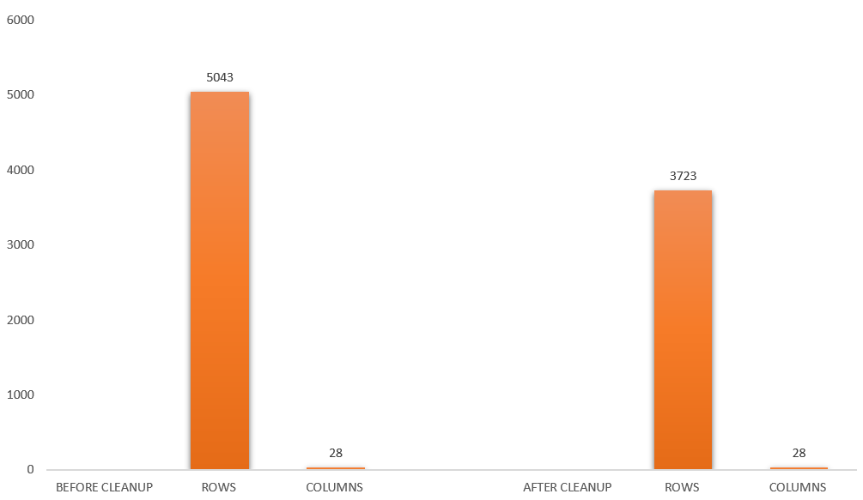
1. Cleaning the data :-
Cleaned the data by removing duplicates, blanks, dropping columns etc.

Slide 6
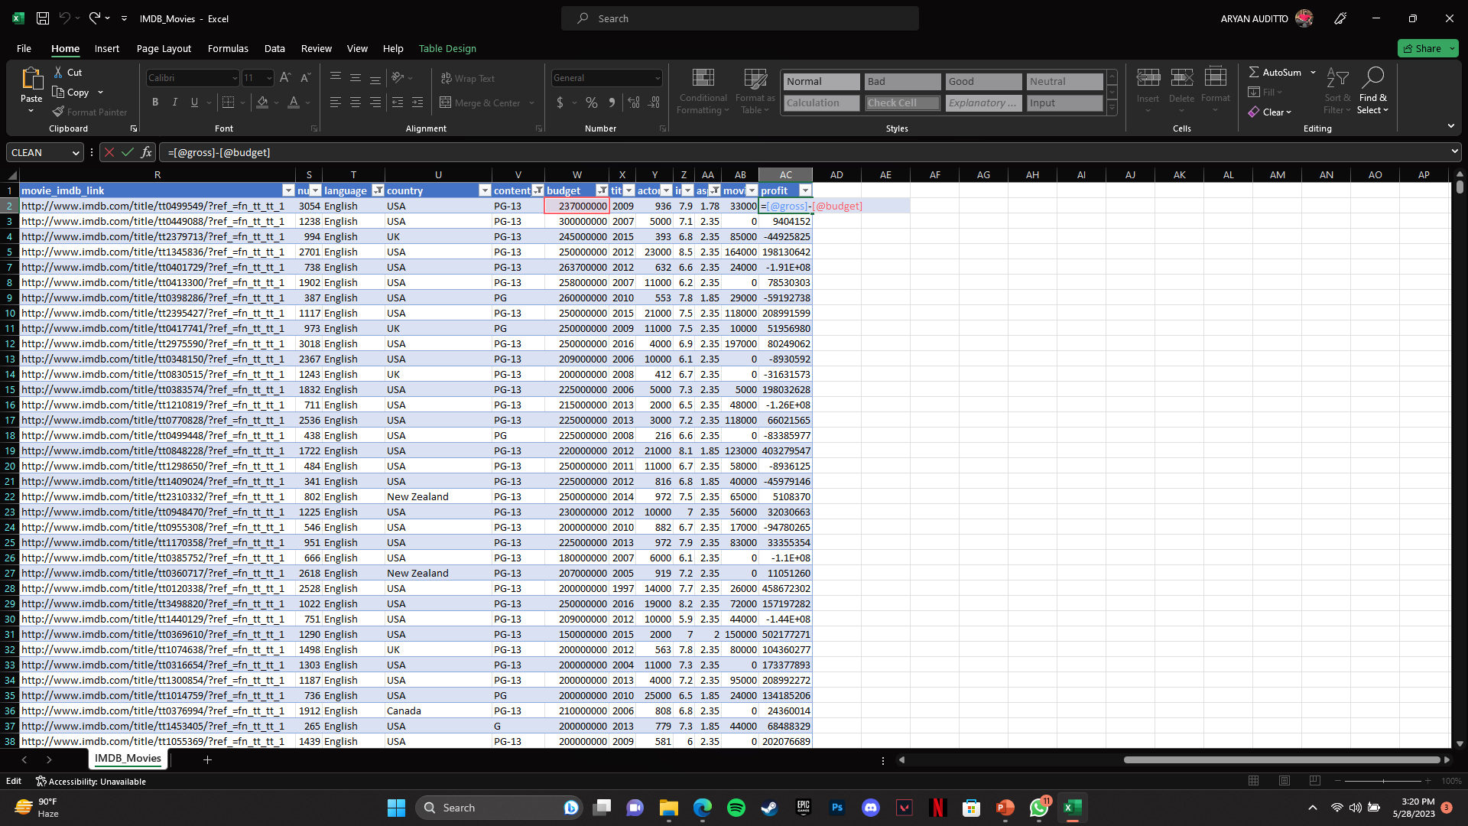
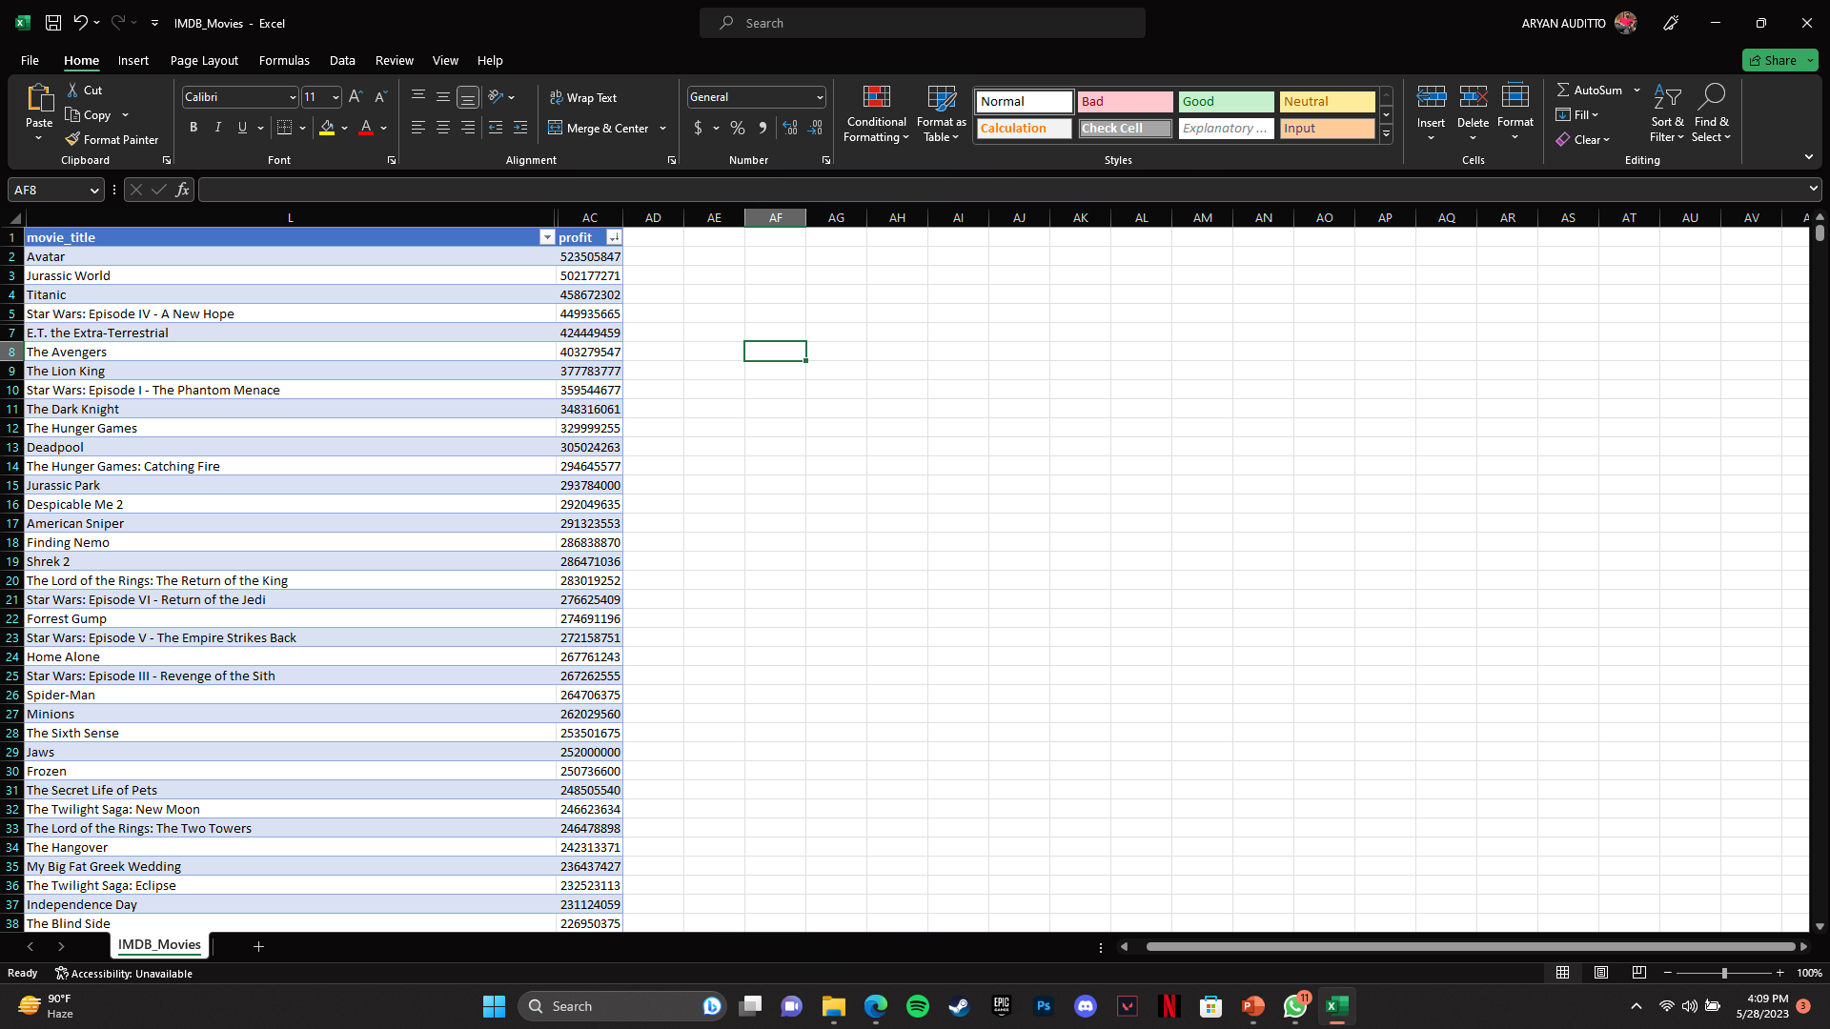
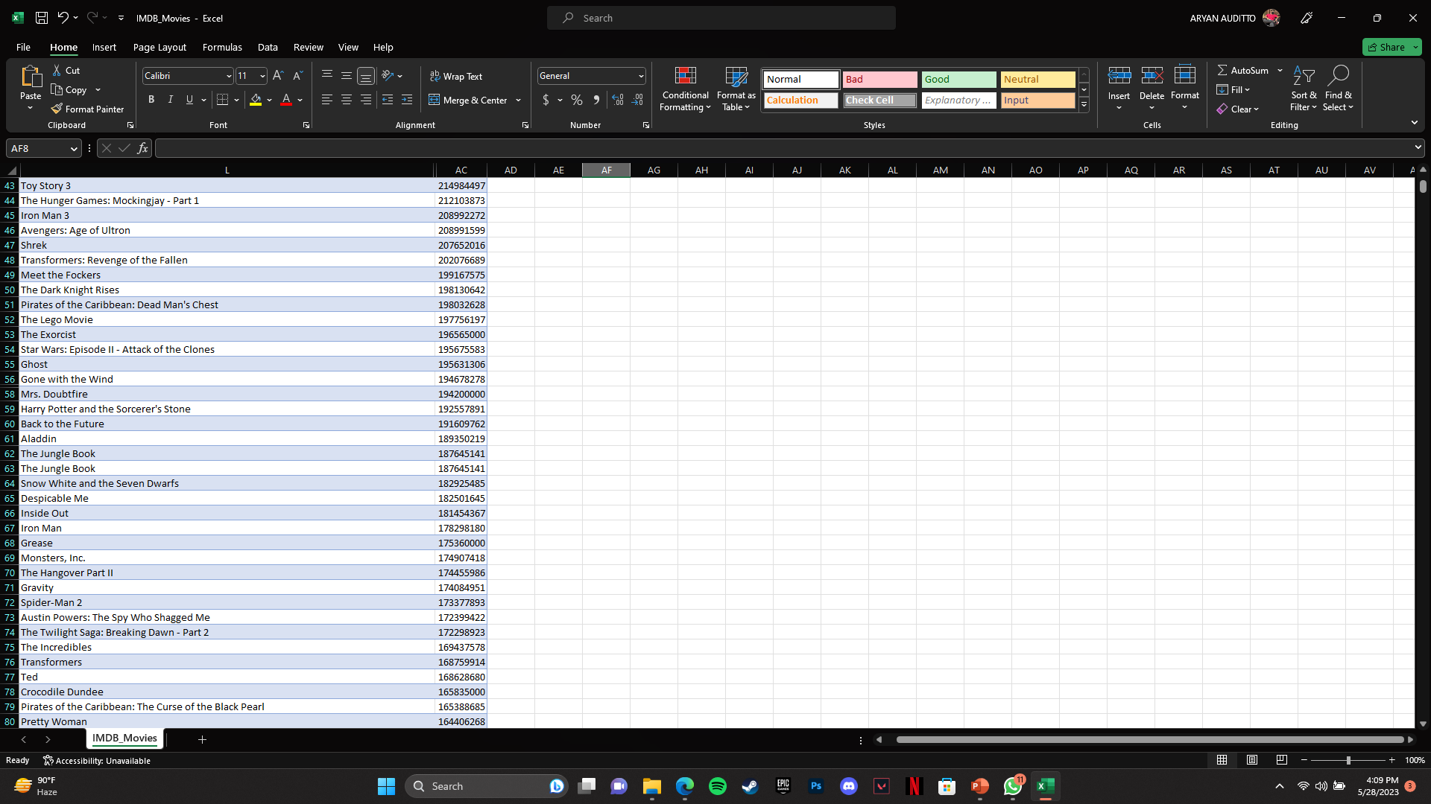
2. Movies with highest profit :-
Formula to determine profit

Slide 7
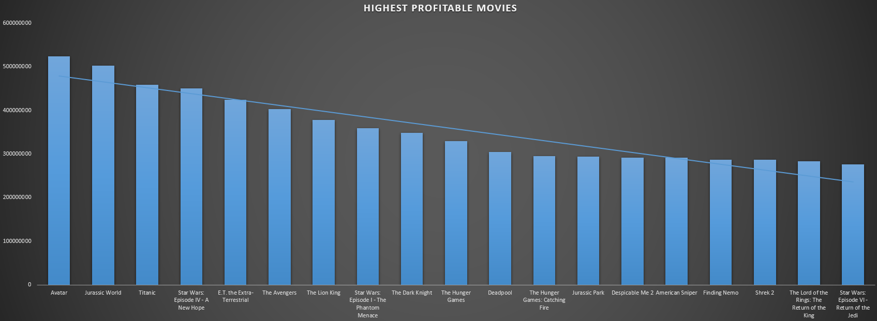
2. Movies with highest profit :-
Avatar is the highest grossing movie according to the analysis

Slide 8
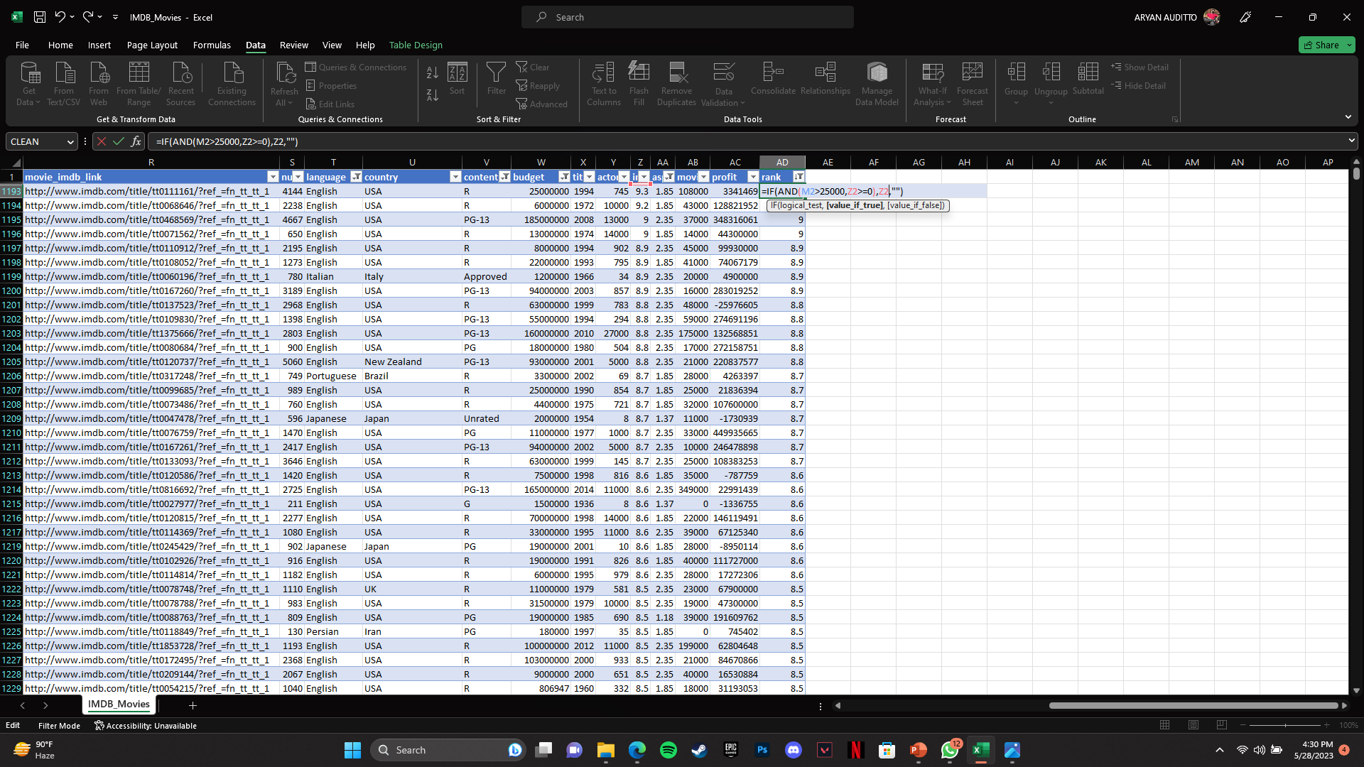
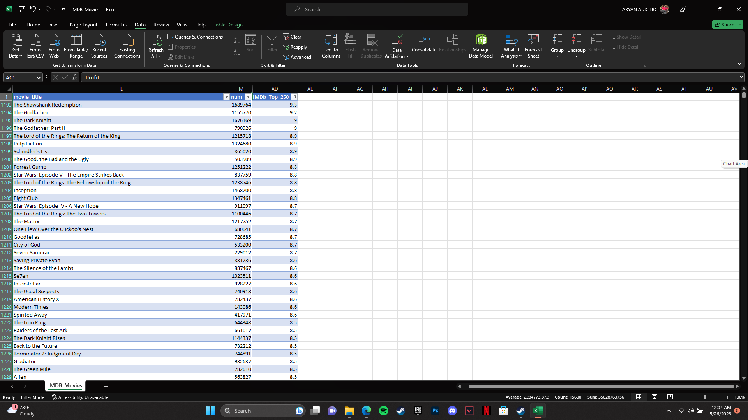
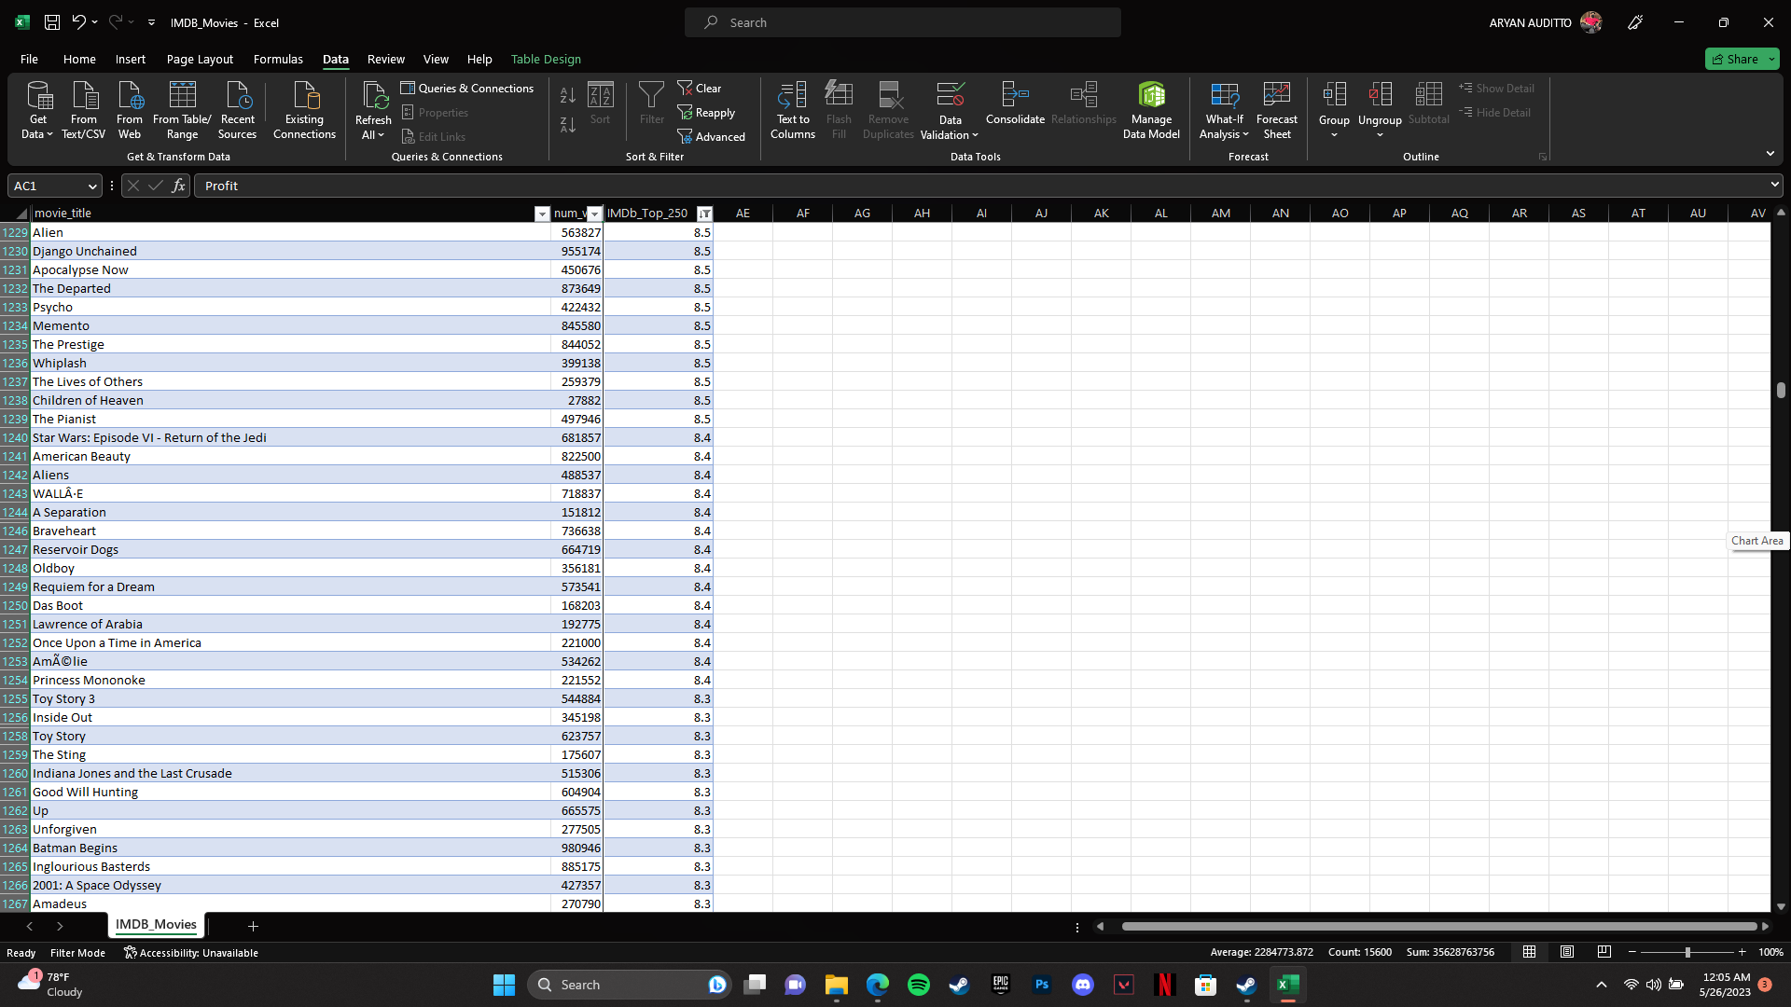
3. Top 250 :-
Formula determines top 250 IMDb movies with num_voted_users greater than 25000
Column M : num_voted_users
Column Z : IMDb ratings

Slide 9
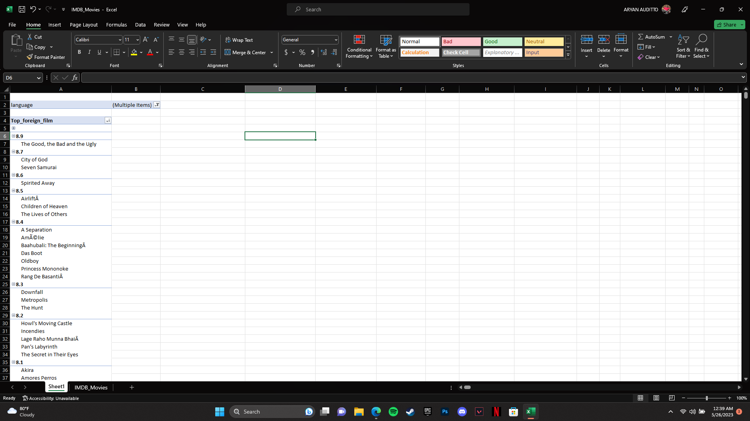
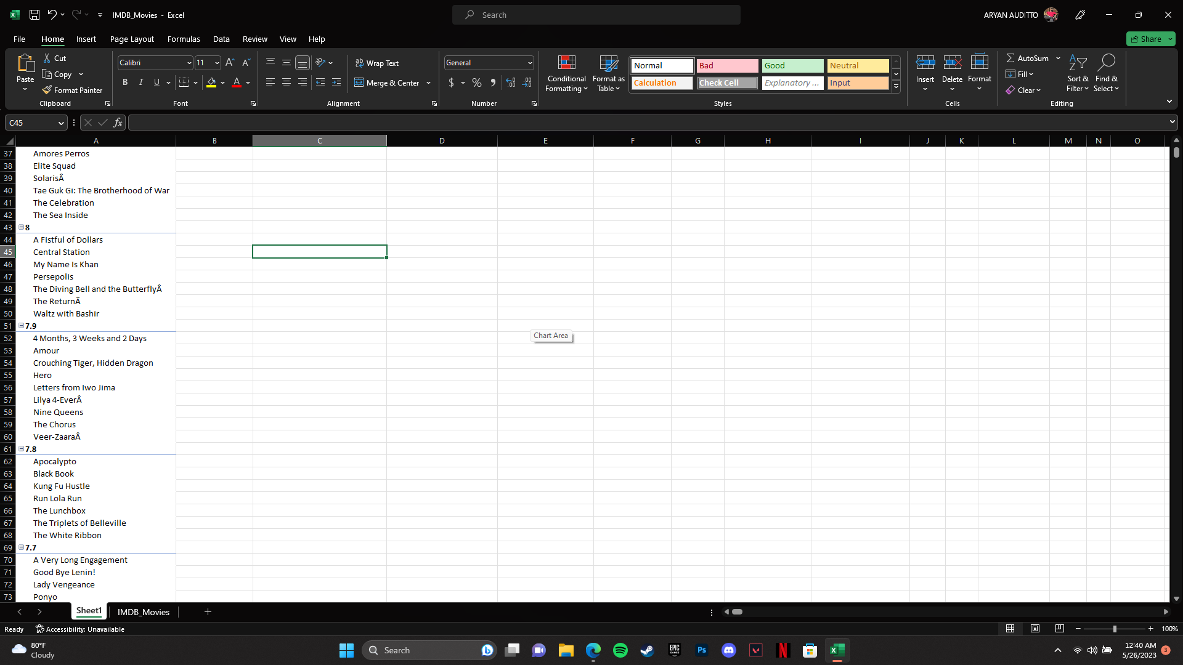
3. Top foreign language movies :-

Slide 10
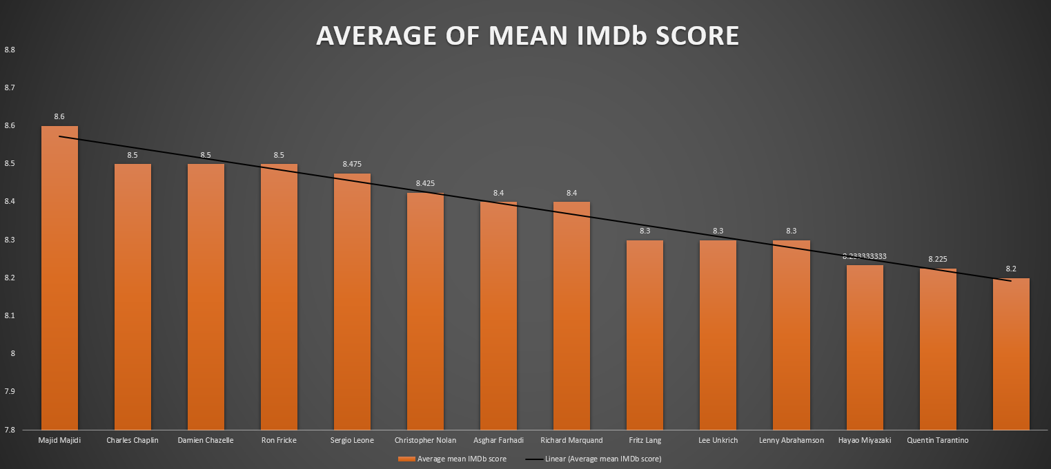
4. Best Directors :-
SHOWS THE BEST DIRECTORS ACCORDING TO IMDb SCORE
Majid Majidi is the best director according to analysis

Slide 11
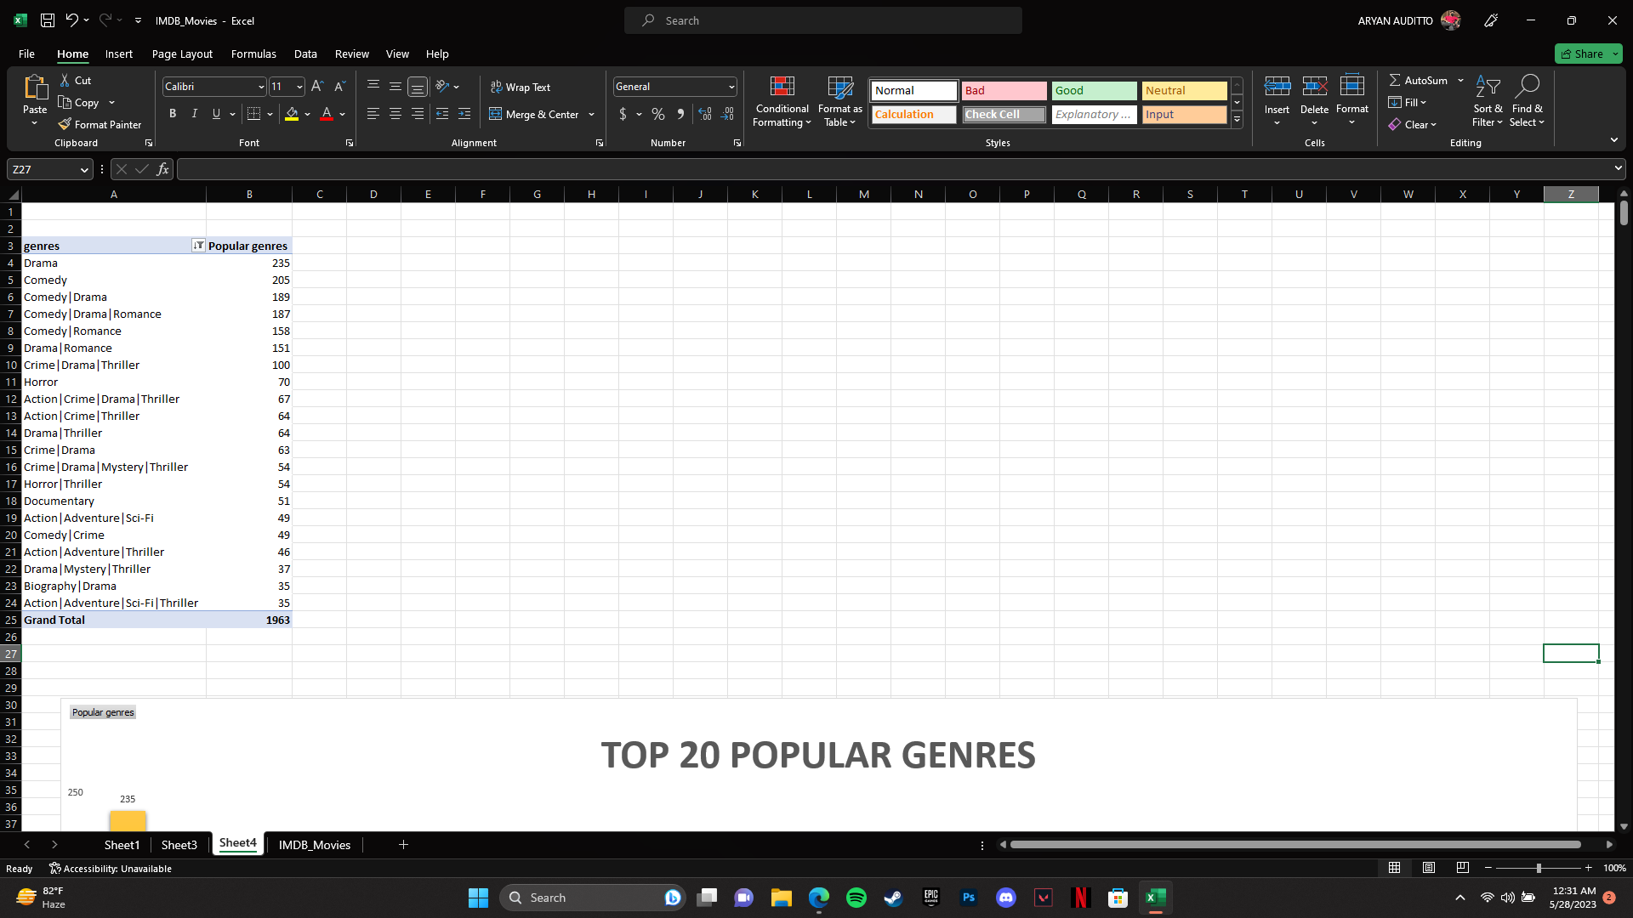
5. Popular Genres :-

Slide 12
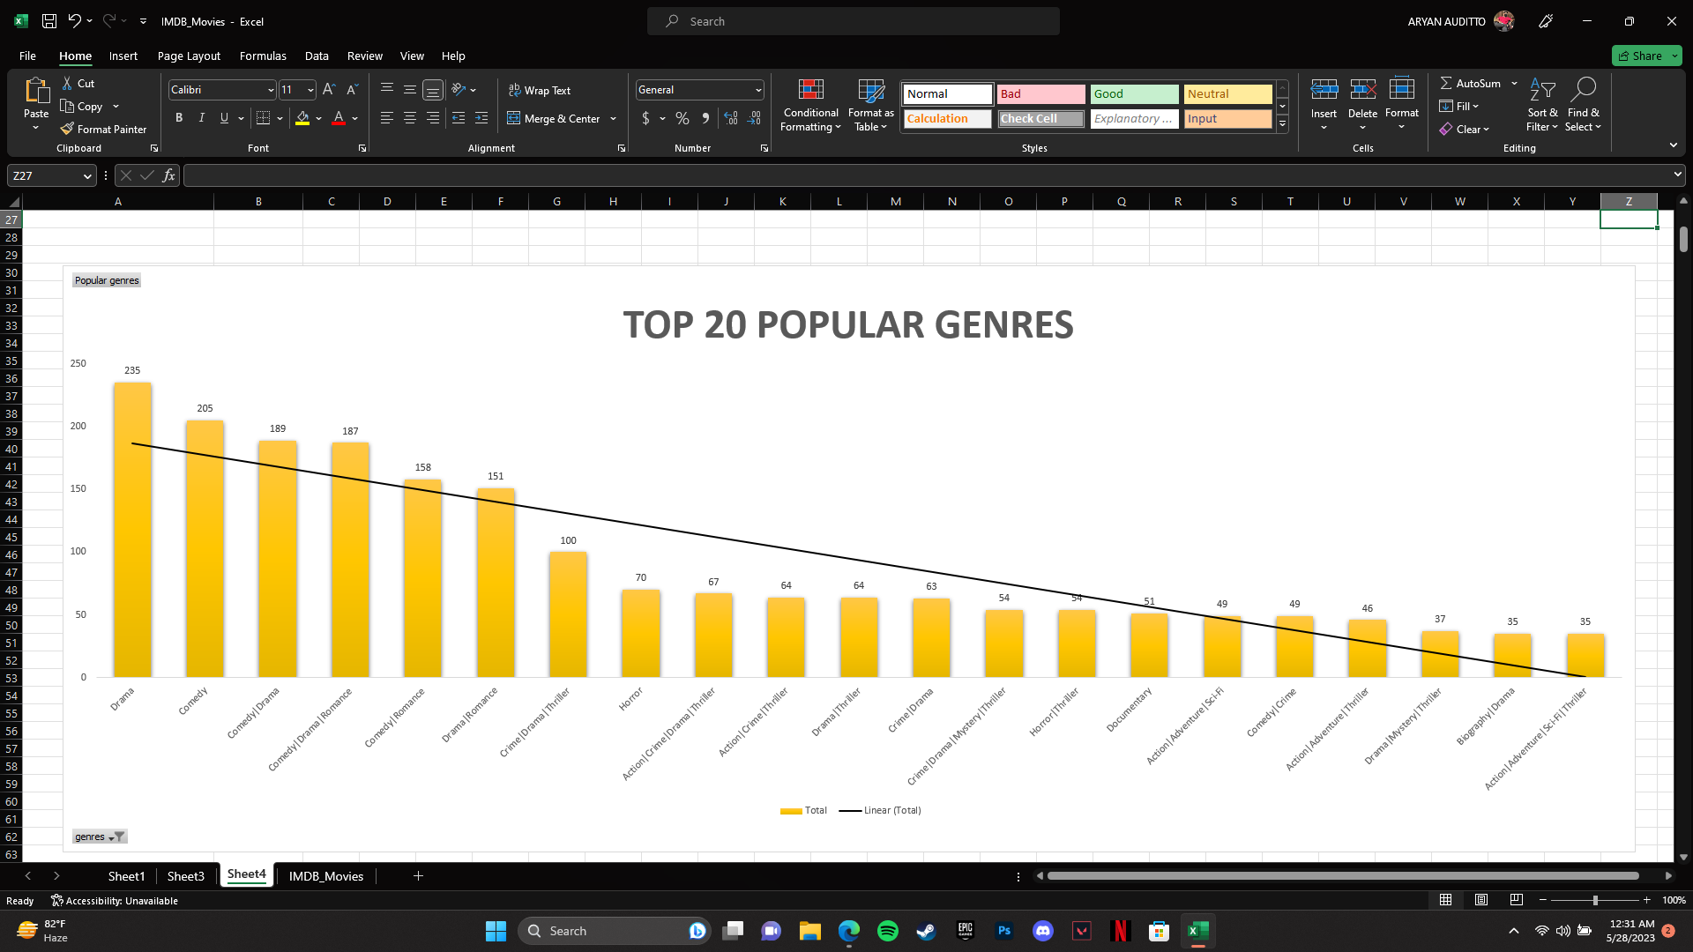
5. Popular Genres :-

Slide 13
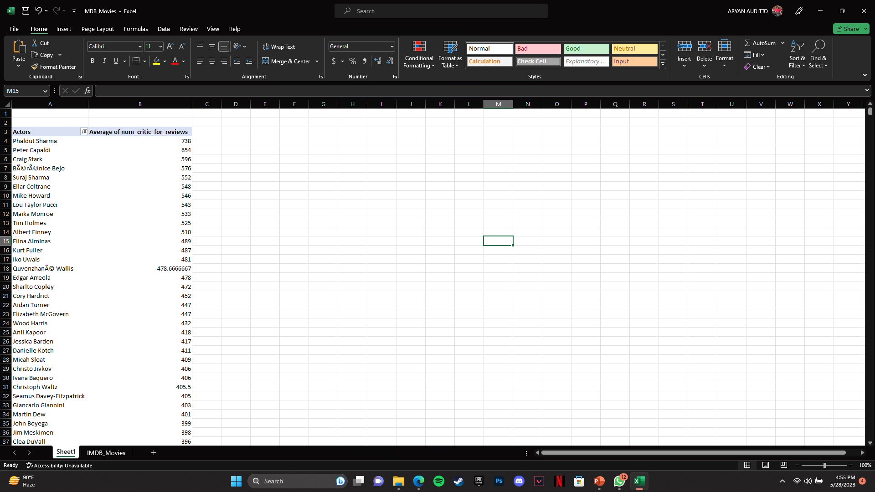
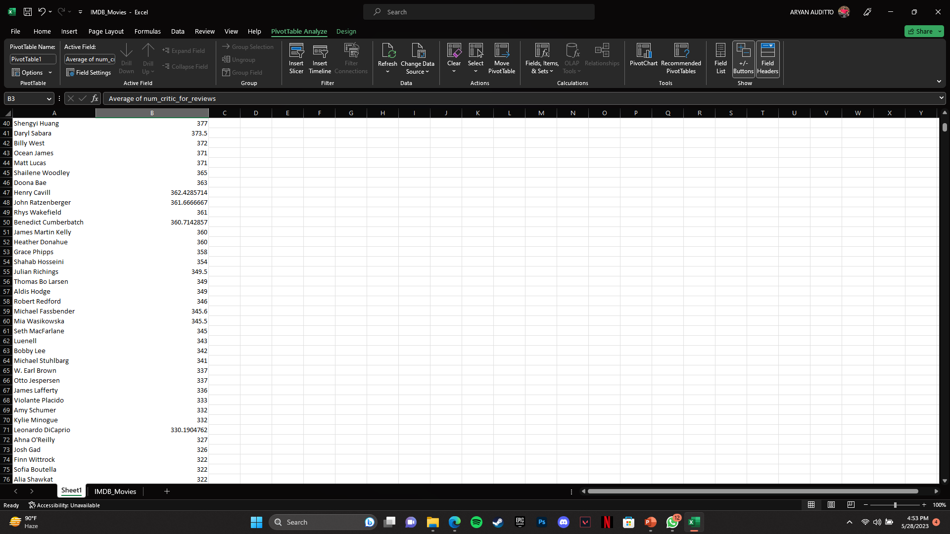
6. Charts :-
Mean for num_critic_for_reviews

Slide 14
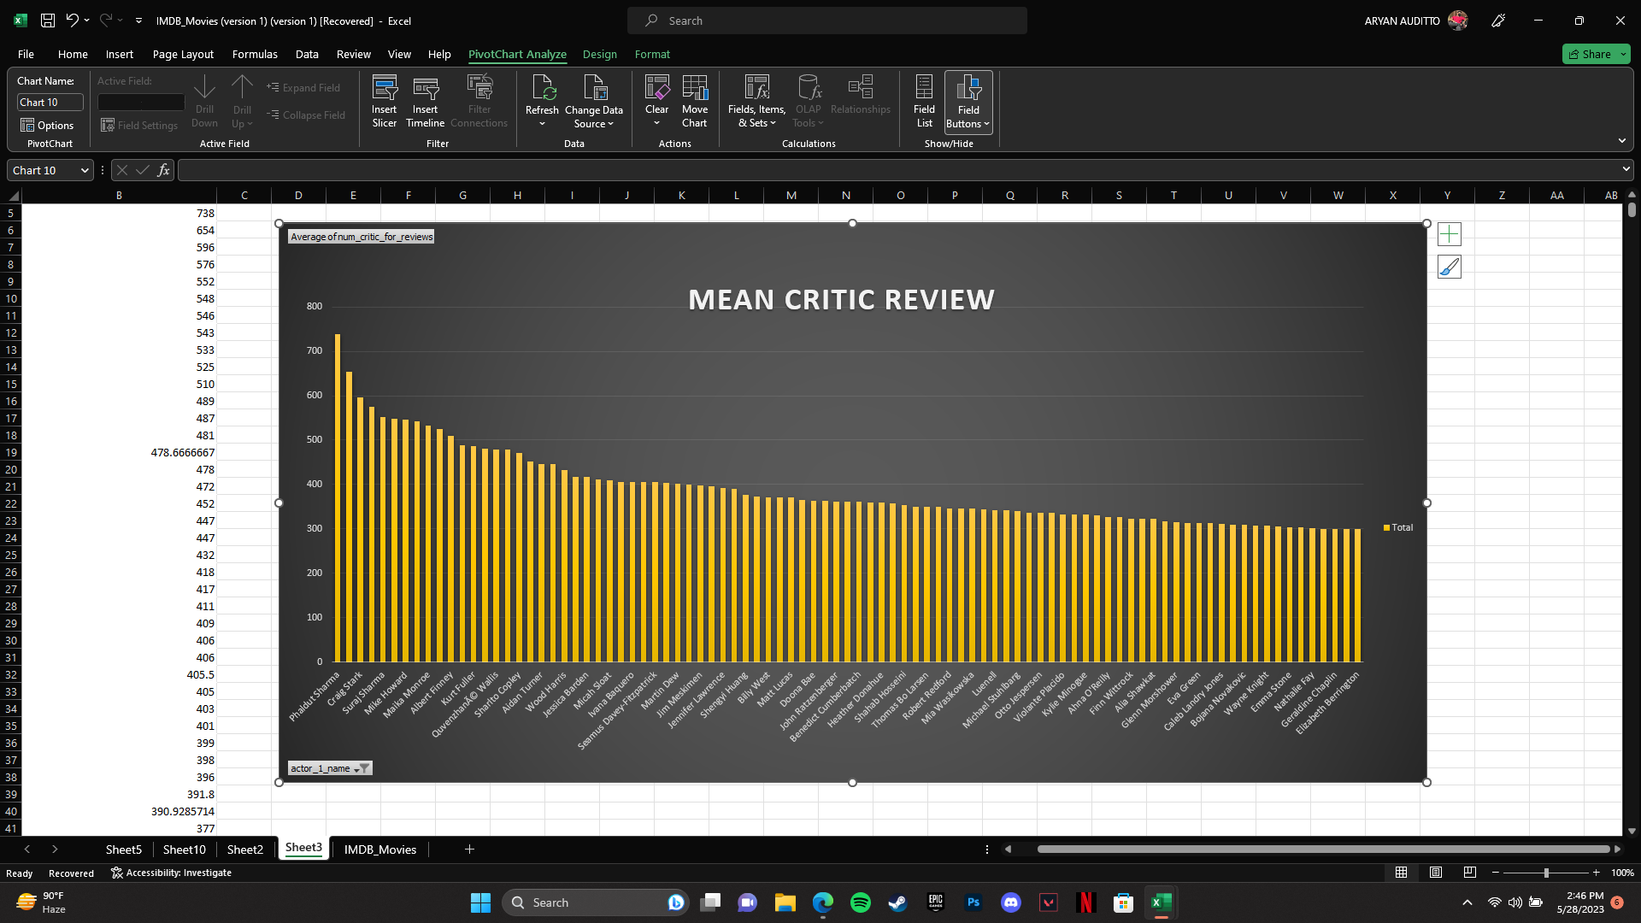
6. Charts :-

Slide 15
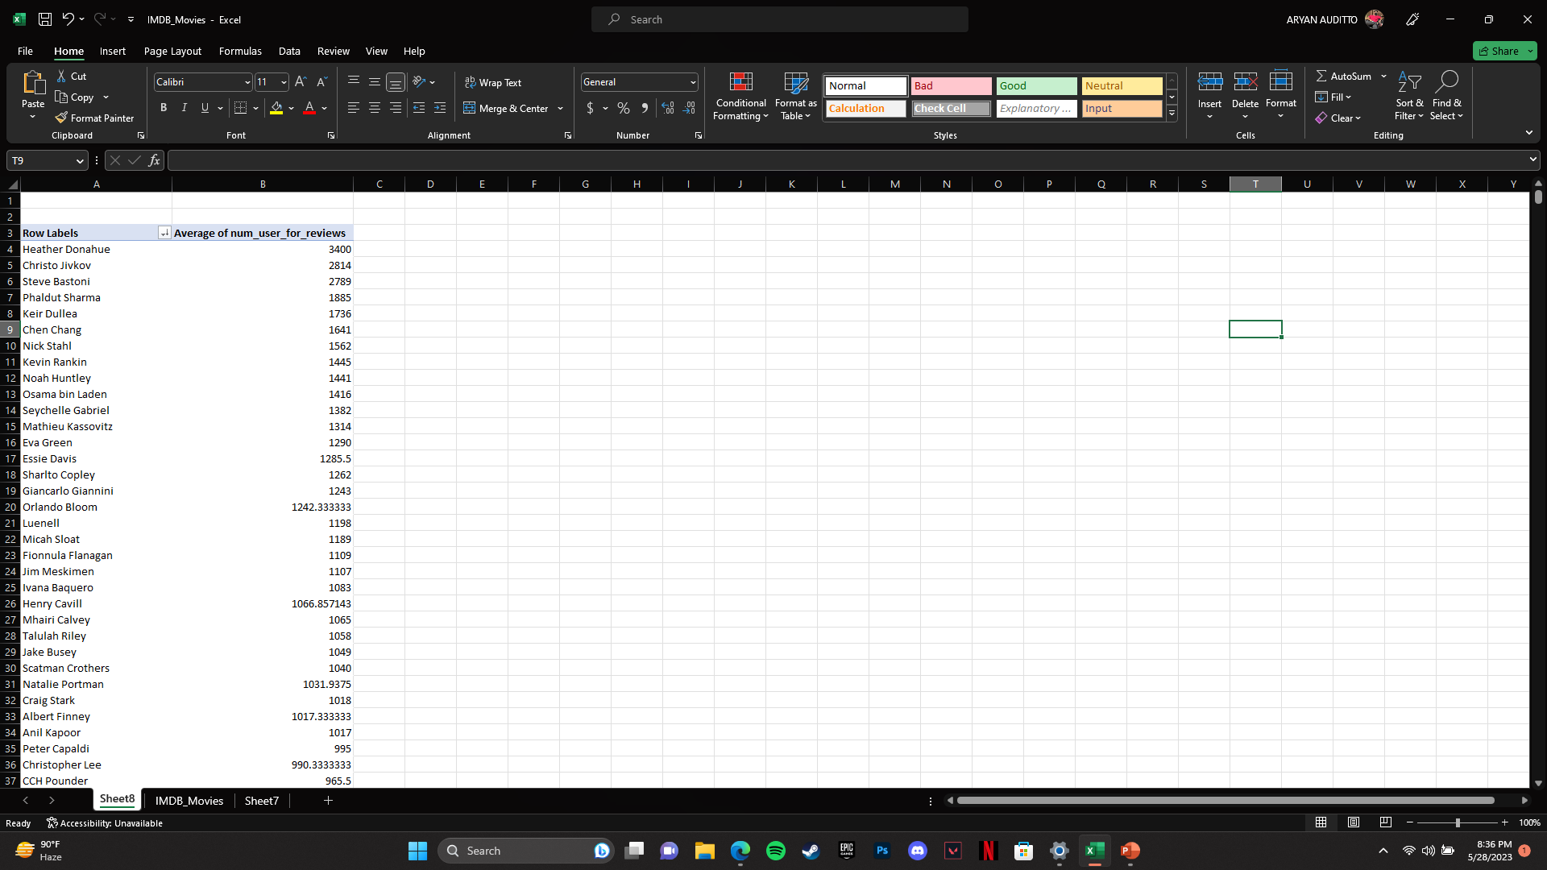
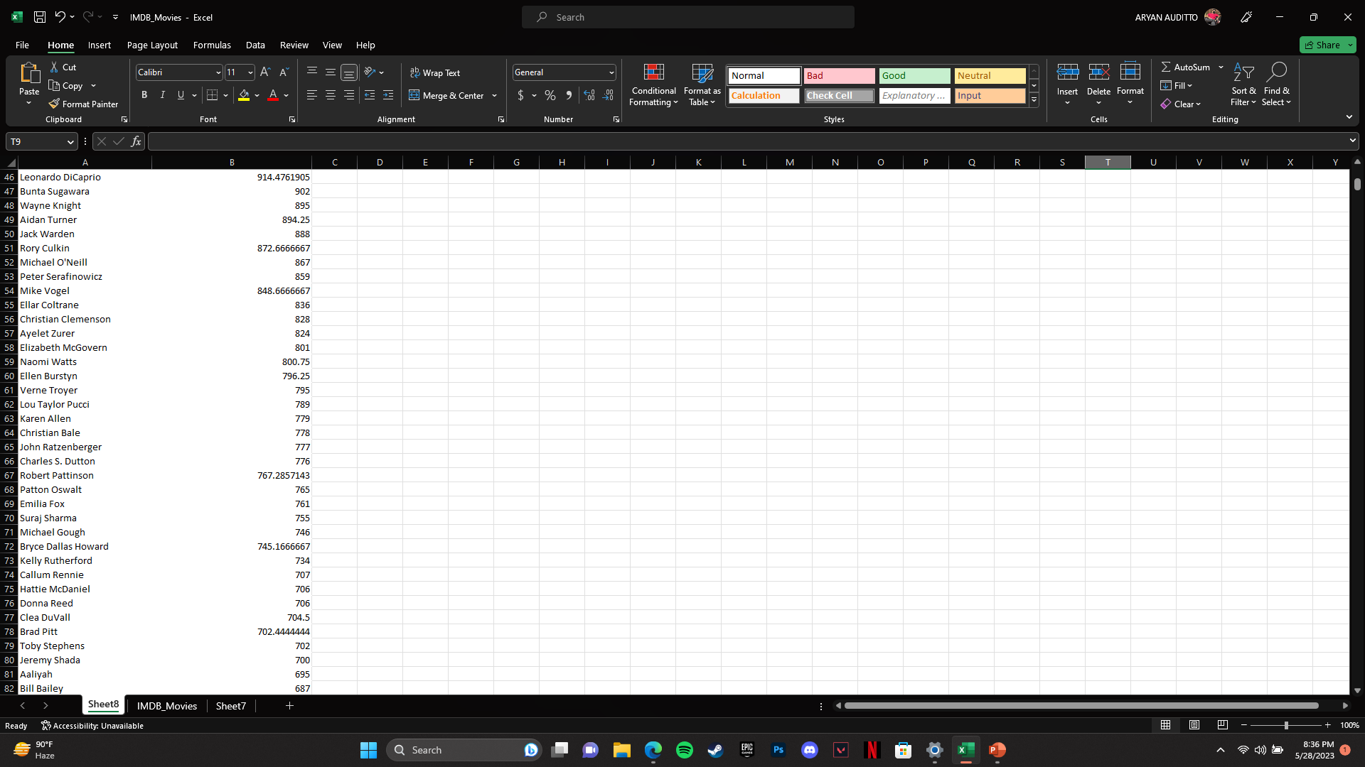
6. Charts :-
Mean for num_users_for_reviews

Slide 16
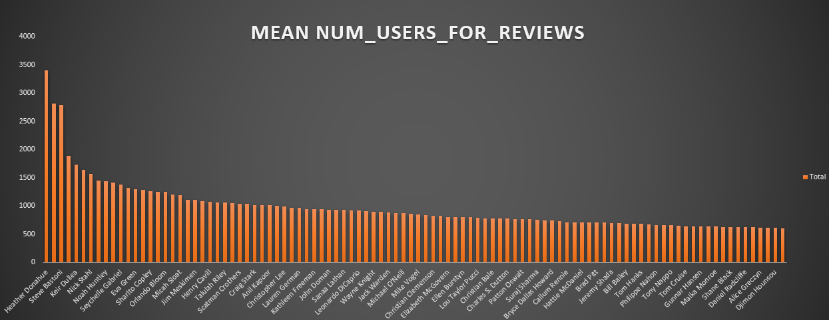
6. Charts :-

Slide 17
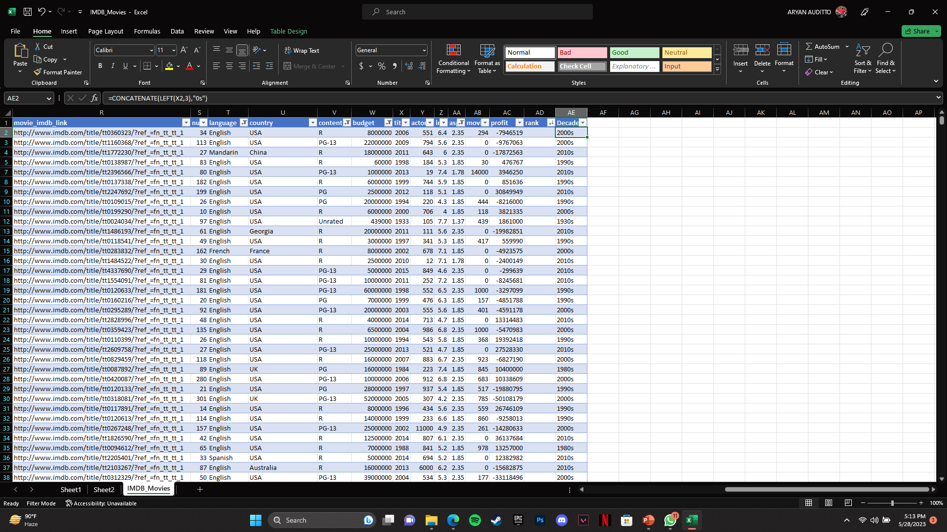
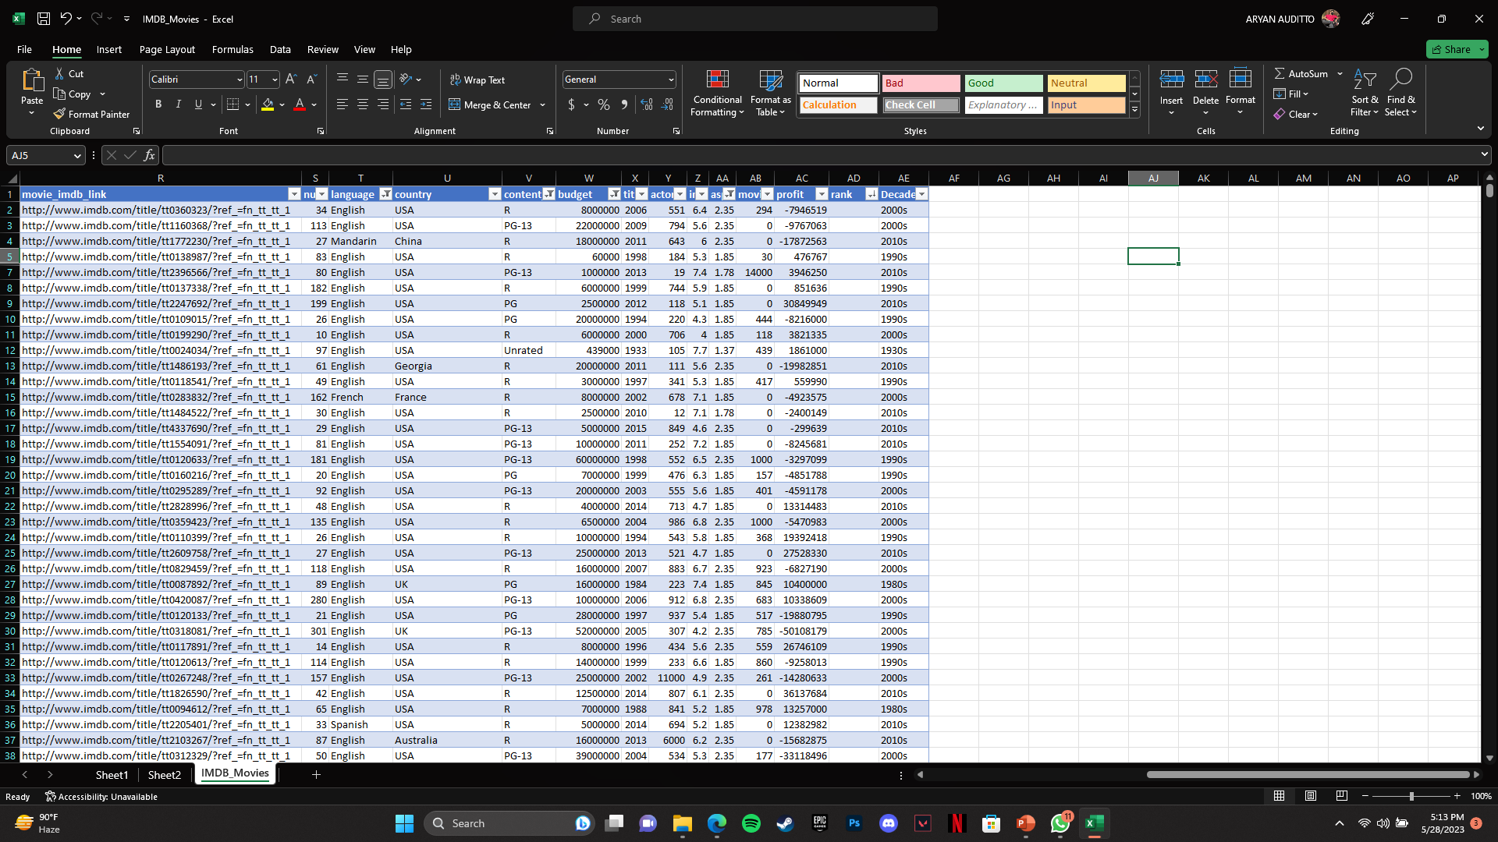
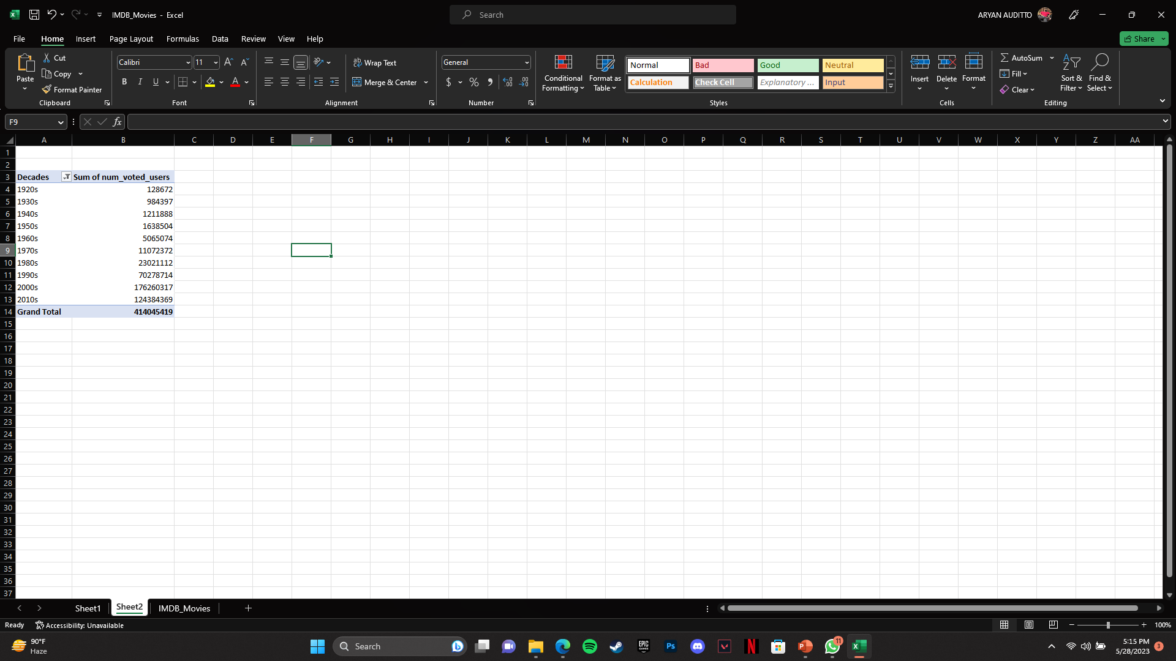
6. Charts :-
Observe the change in number of voted users over decades using a bar chart.

Slide 18
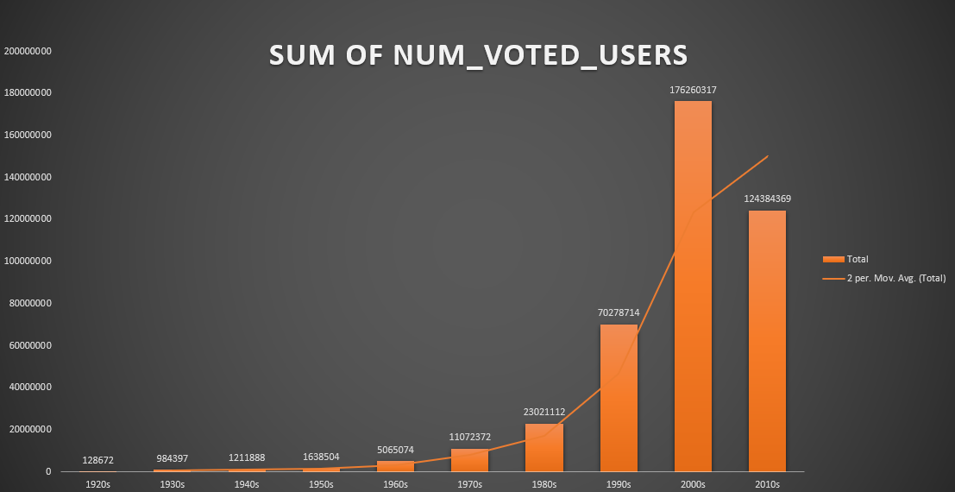
6. Charts :-

Slide 19
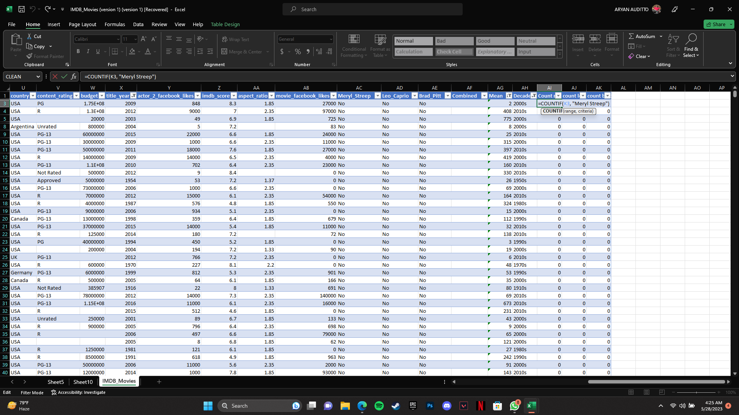
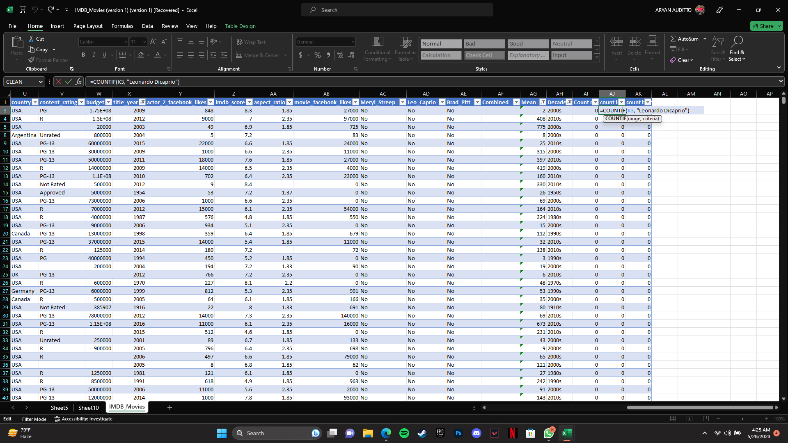
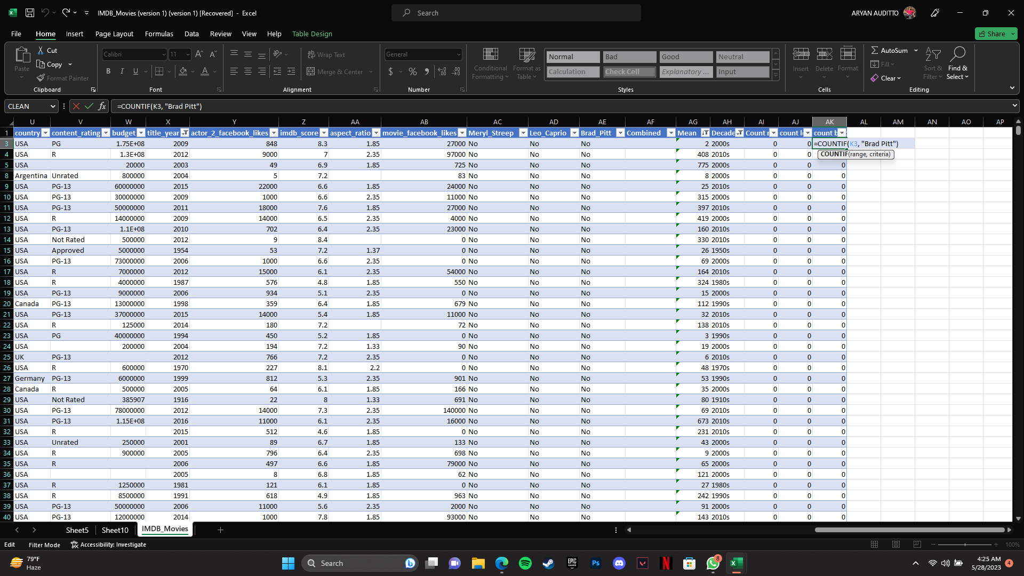
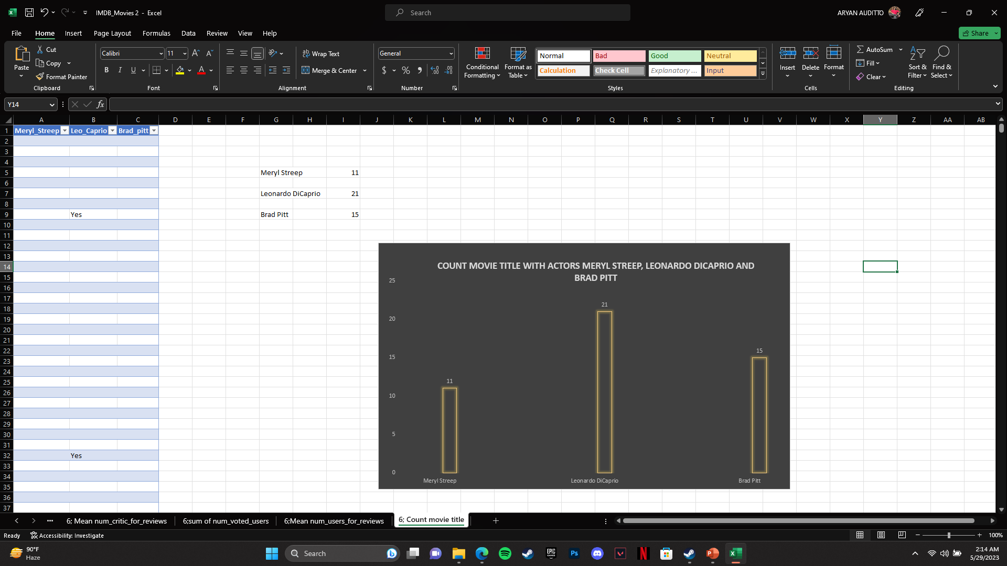
6. Charts :-

